Slide 1
When Do We Need Emergency Services?
Analysing Vic Roads crash data
August 2023
Andre Medina

Slide 2
Why?
How many emergency services do we need?
Should we reallocate the current distribution?
Where should we send Ambulances & Police in the moment?

Slide 3
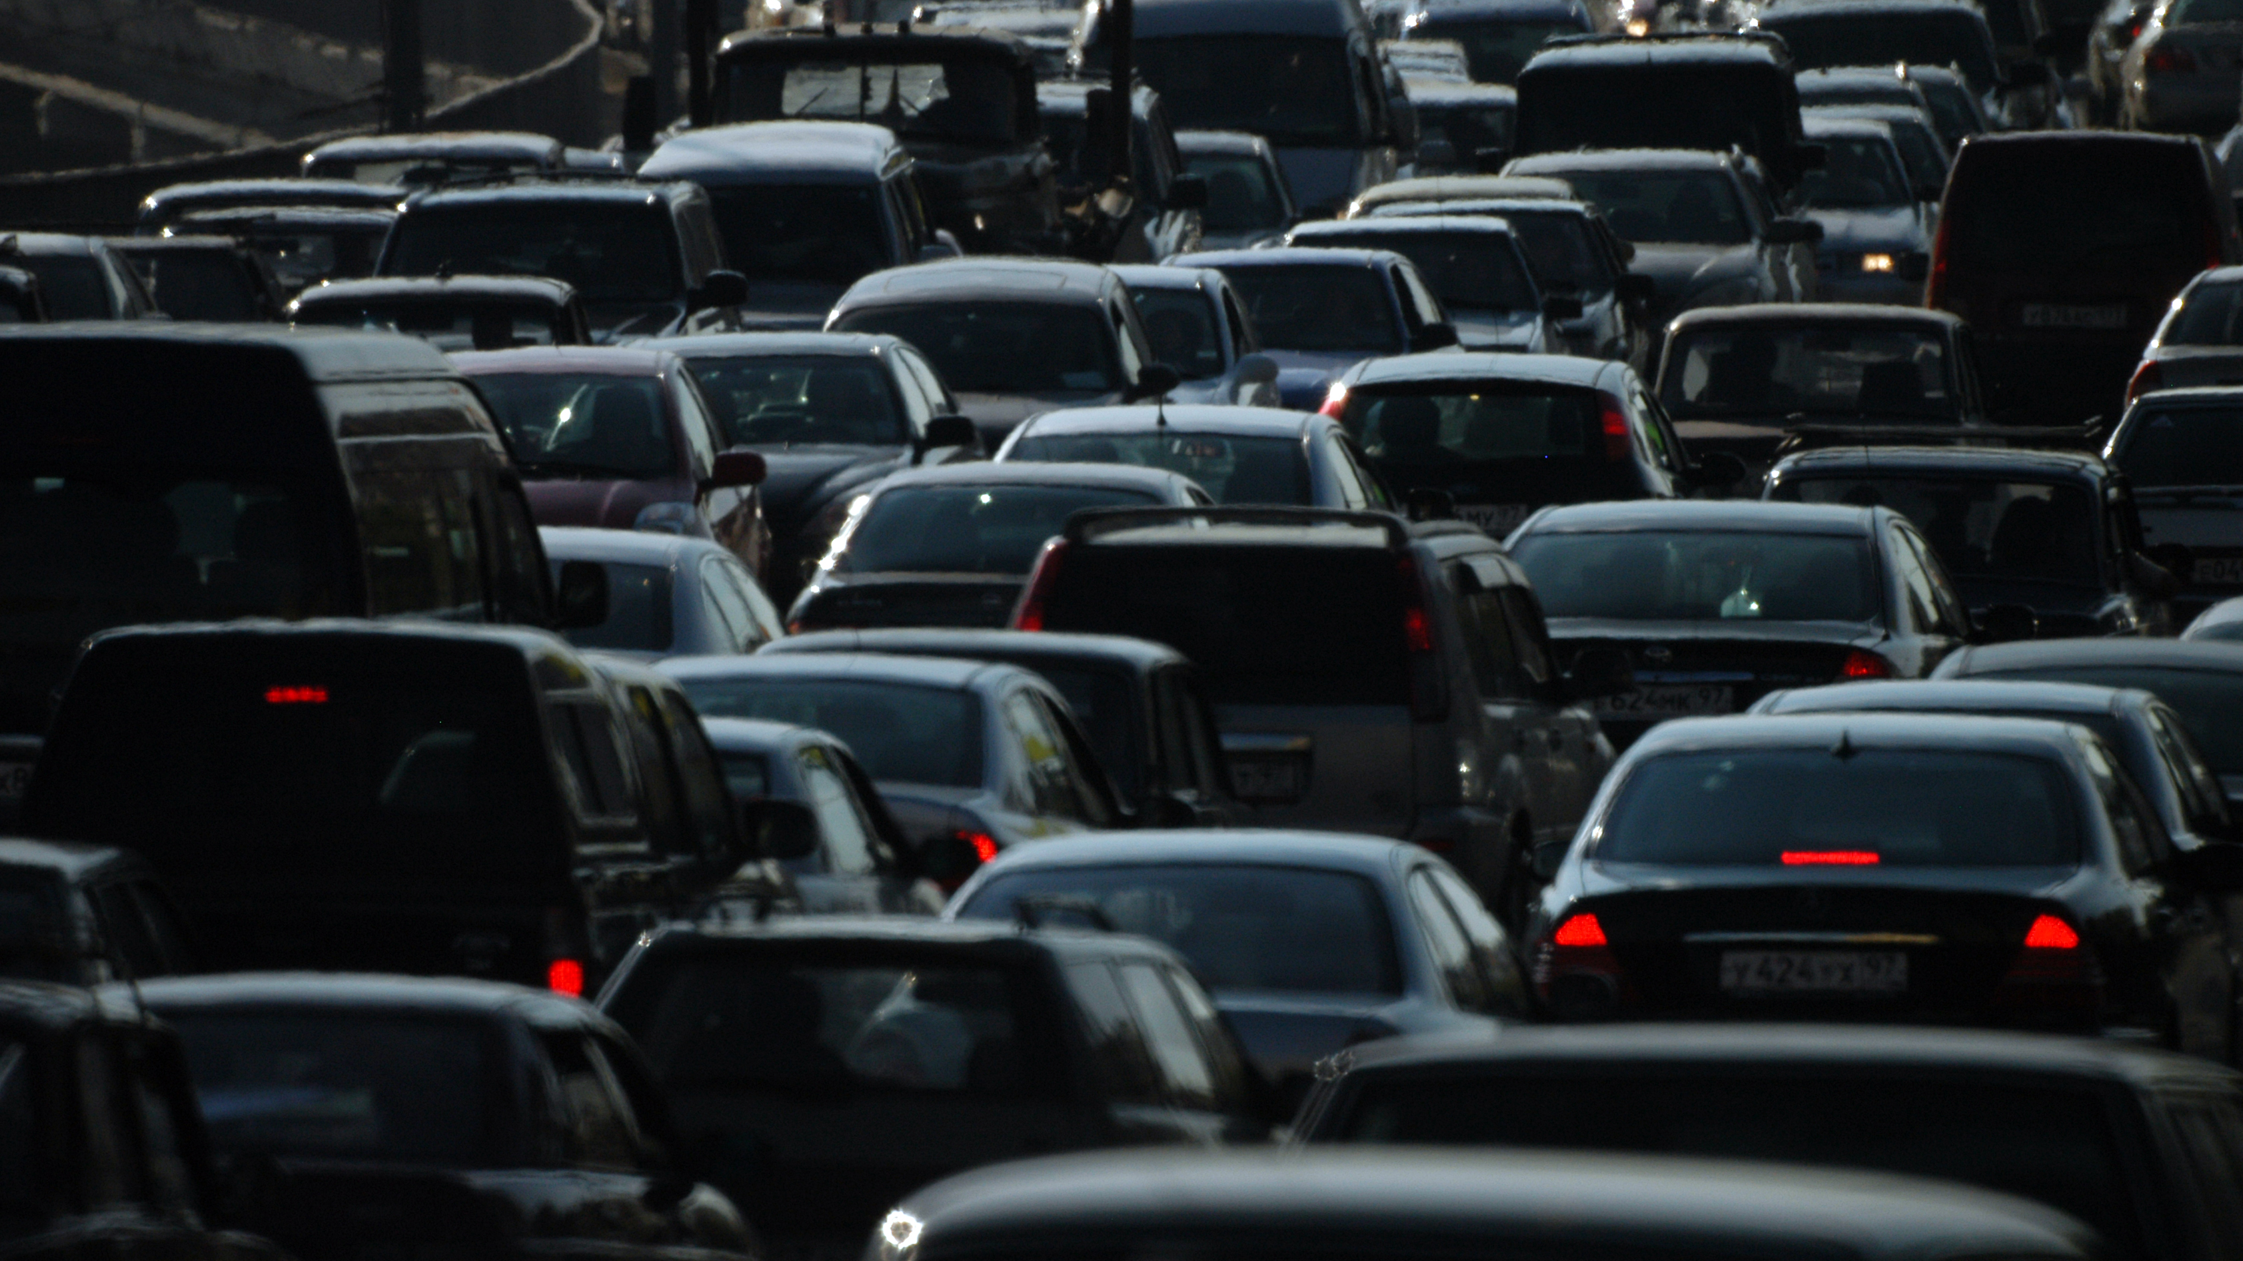
How?
The crash data!
Find key metrics
Group the crashes
Number of times 000 arrived
Convert to a percentage
Create a statical model

Slide 5
Major steps
Investigating data structure
Viewing initial trends
Further data cleaning
Final statistical model
General data wrangling

Slide 6

Investigating Structure & Wrangling Data

Slide 7
Initial Data Structure
Pre-Crash data
Time of accident
Atmospheric condition
Road condition
Local Government Area (LGA)
Light Condition
Post-Crash data
Severity
Number of people involved
Accident Type
Police Needed
Ambulance Needed

Slide 8
Simplifying Data
Pre-Crash data
Day of the week
Part of the day
Atmospheric condition
Road condition
LGA / Region
Post-Crash data
Police Needed
Ambulance Needed

Slide 9

Ambulance Needed
Each crash was linked to a group of people
Each person had their injury severity recorded
If someone was taken to the hospital, it was recorded

Slide 10

Viewing Initial Trends

Slide 11
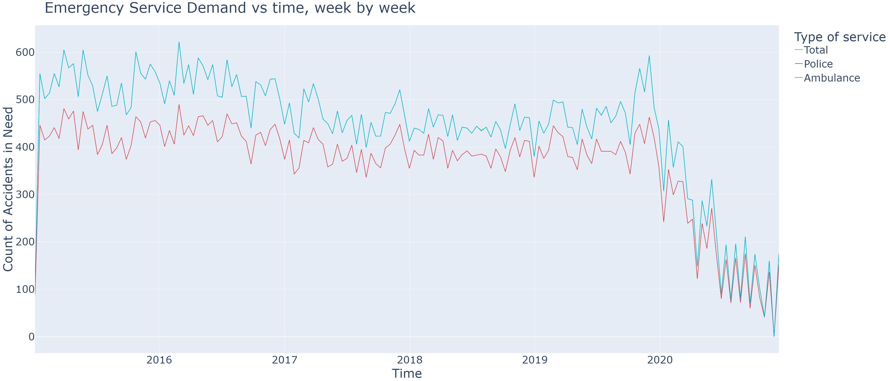
Emergency Callouts Over Time

Slide 12
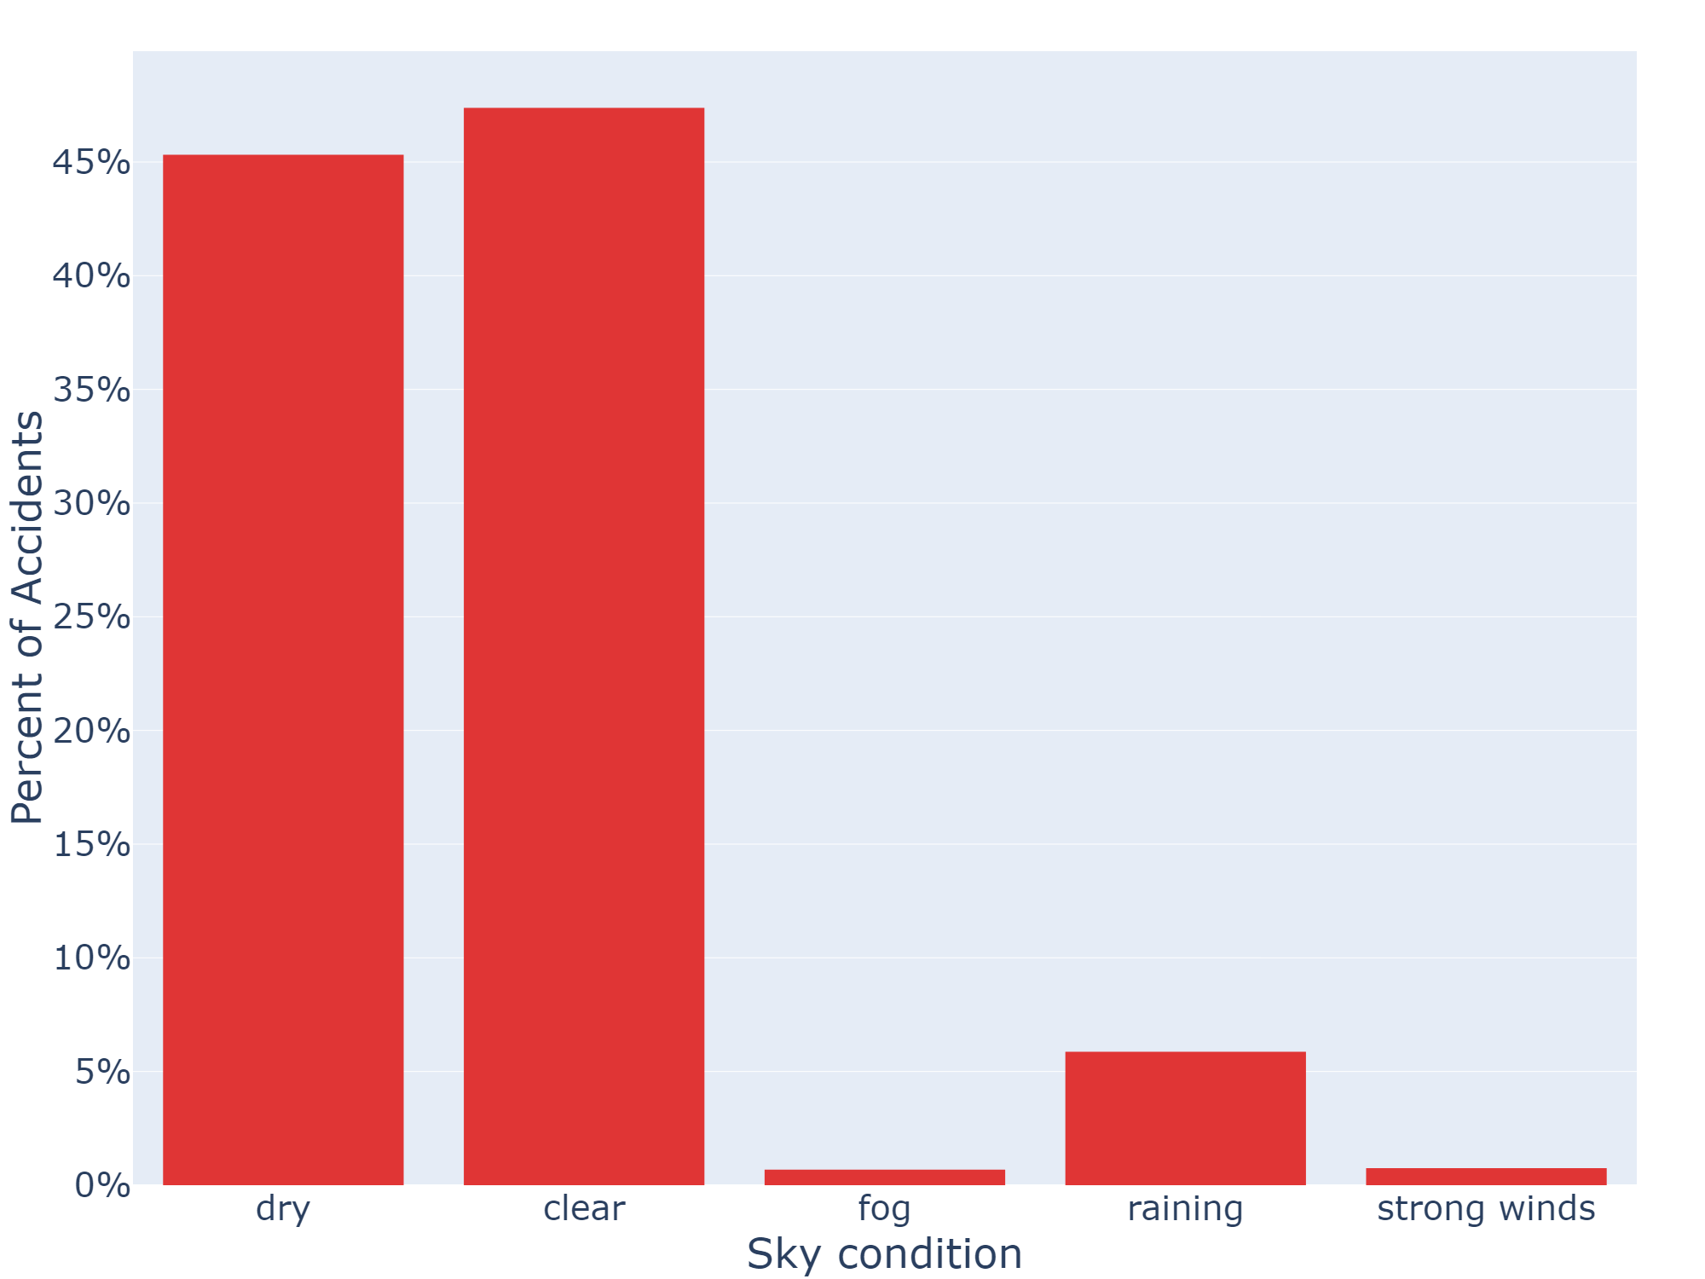
Crashes by Road and Sky Conditions

Slide 13
Correlation of Conditions

Slide 14
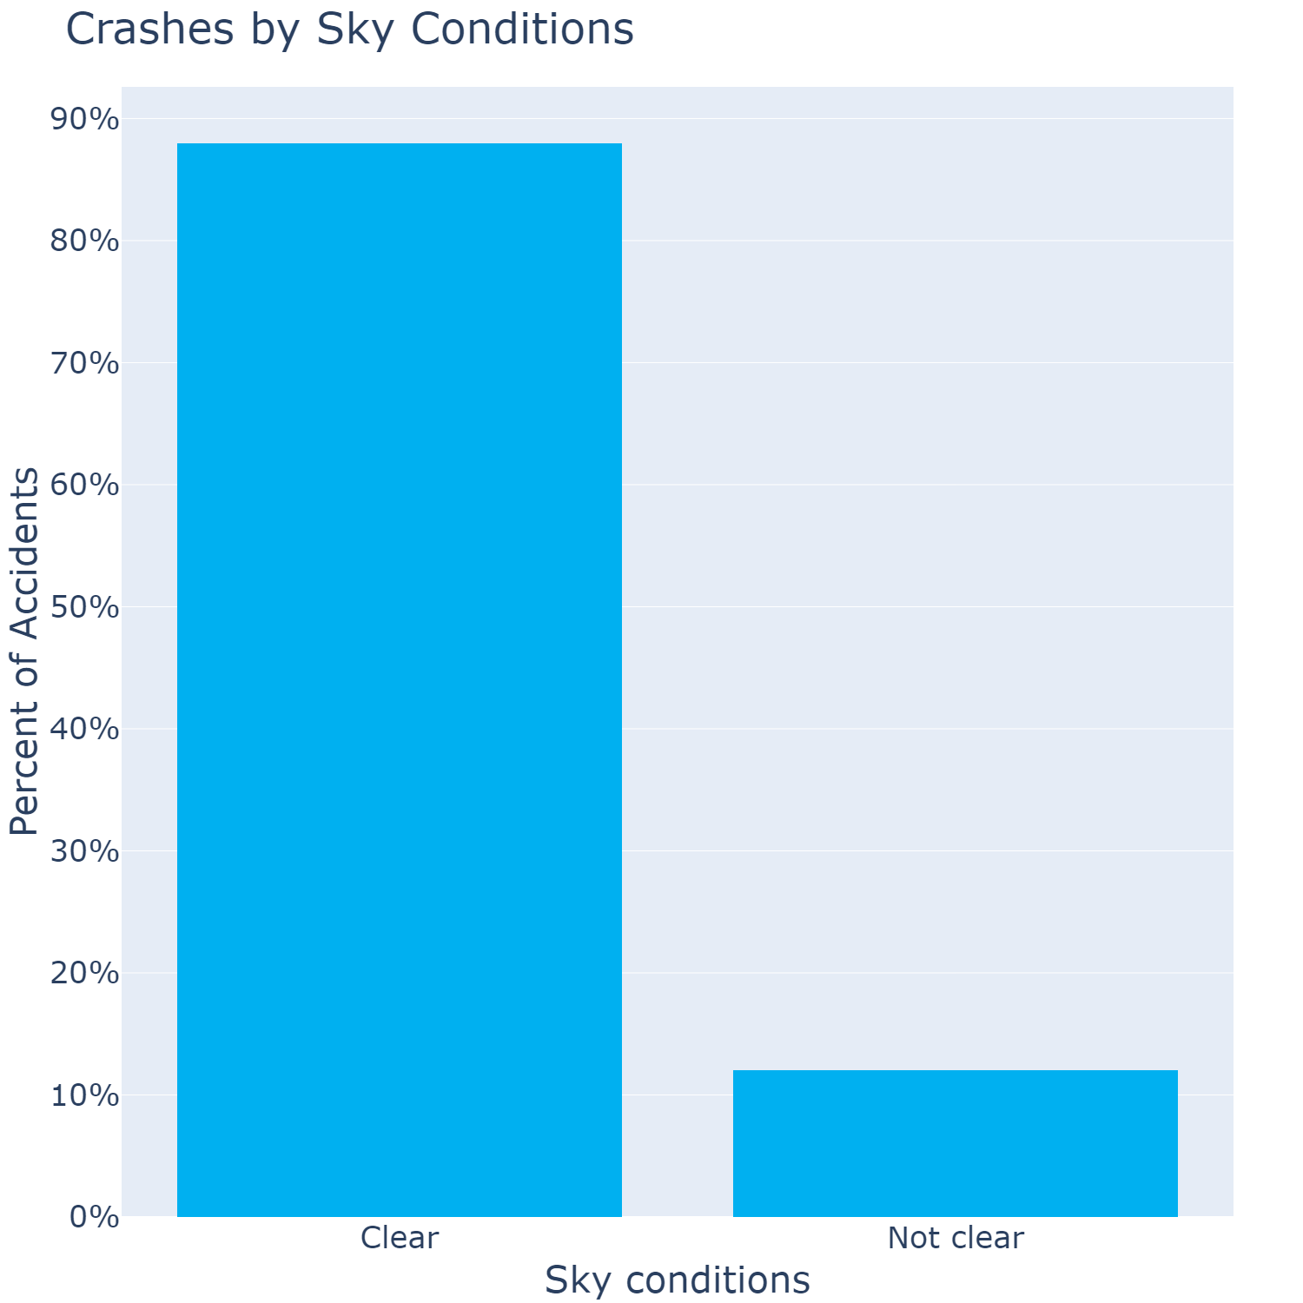
Crashes by Sky Conditions

Slide 15
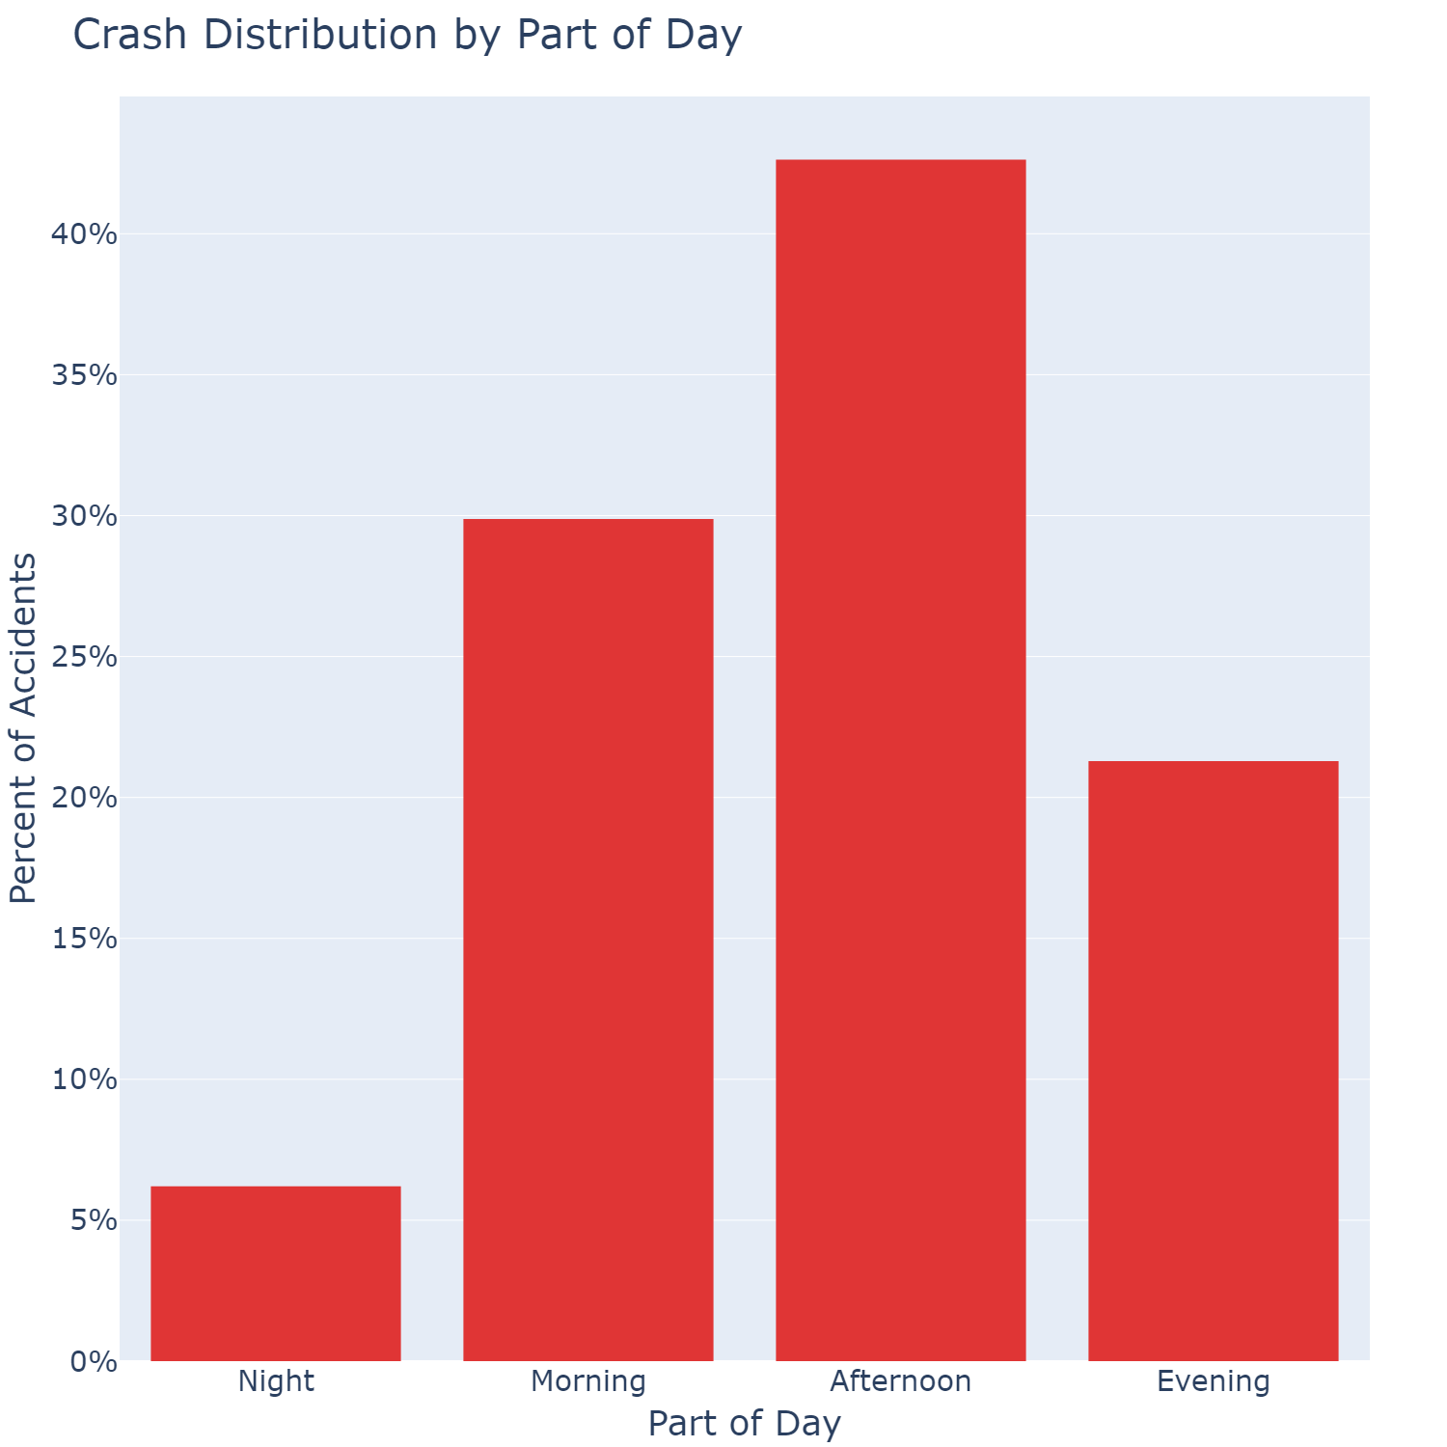
Crashes by Part of Day

Slide 16
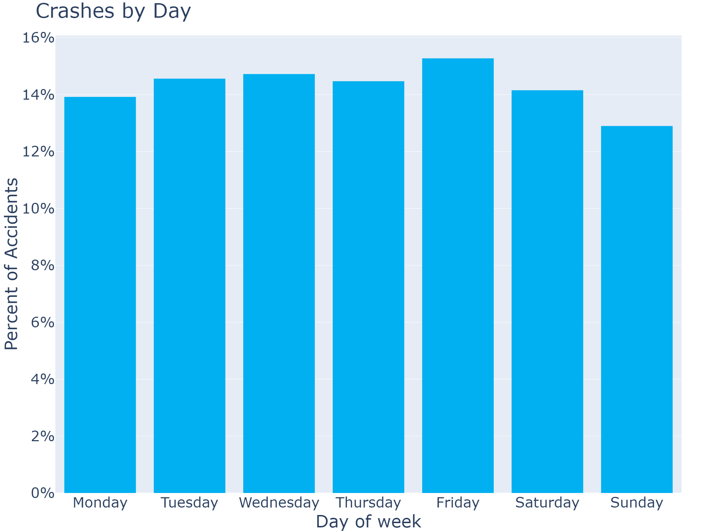
Emergency Callouts Over Time

Slide 17
Crashes by Day

Slide 18

Further Cleaning

Slide 19
Target Format
For each combination of
Sky condition
Region
Day of the week
Part of the day
Calculate average number of emergency services

Slide 20
Issues
Regional areas have smaller number of samples
Data is already split up into rainy days and clear days
Both breakdown and average over time

Slide 21
final format dist

Slide 22

Final Statistical Model

